Slide 1
Automatically Timetable Generation
Under the supervision of
Javed Ahmed

Slide 2
AUTOMATICALLY TIMETABLE GENERATION
Submitted by:-
1.USAMA ASIF :18DCS067
2.UROOSA :15DCS0060
3.SHIFA NOOR :18DCS062
4.SADIQ WASIM :

Slide 3
Introduction
Title of our project is “Automatic time table generation”.As the name suggests , it is an application which generates timetable .It is a simple, easily understandable, portable and efficient application.
It could automatically generate good quality time tables within seconds.Normally ,timetable generation done manually. Preparing timetable manually consumes a lot of time. So, our aim here is to develop a simple, easily understandable, efficient and portable application, which could automatically generate good quality timetable quickly.

Slide 4
What is the objective?
The application will make the procedure of time table generation easier consistently which may otherwise need to be done using spread sheet manually which might lead to constraints problem that are strenuous to establish when time table is generated physically. The purpose of the algorithm is to generate a timetable schedule mechanically. Our objective is to increase accuracy of proposed system and to reduce paperwork and labour work.

Slide 5
Why are we making it ?
1)It enables us to visualize what we have got in our schedule for the day and across the week.
2) To tackle time mismanegement.
3)To plan long-term.
4)Timetable yields better results.

Slide 6
How are we making it?
Programming languages used are :
Html
Php
Css
Javascript
MySql

Slide 7
Registration activity
Front end: It consist of text view , edit texts for username ,email and password and a button to create an account.
Bac k end : Here we database to register the user. When the user registers , a unique key is generated which is unique to every user.

Slide 8
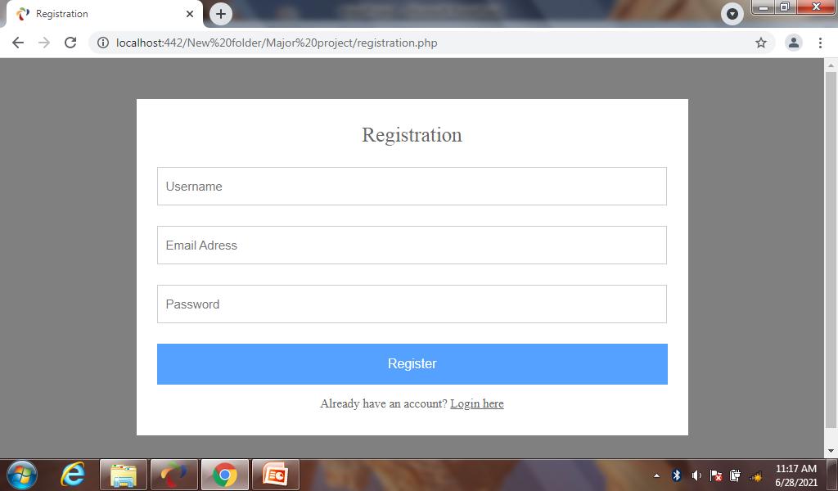

Slide 9
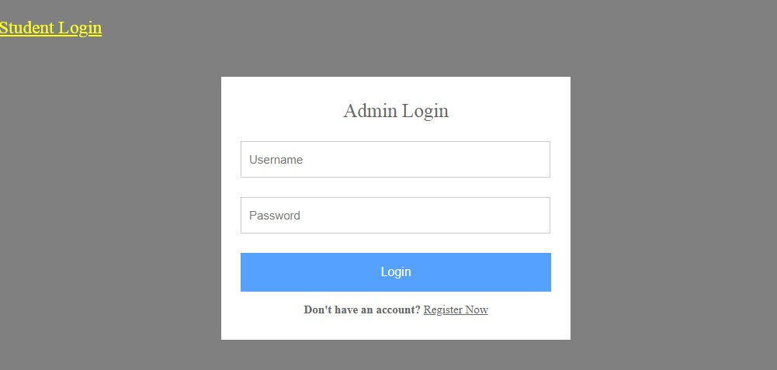
Login activity
Front end : It consist of text view , edit texts for username and password and a login button.
Back end : Login activity uses database . It stores the username and password of every indivisual.

Slide 10
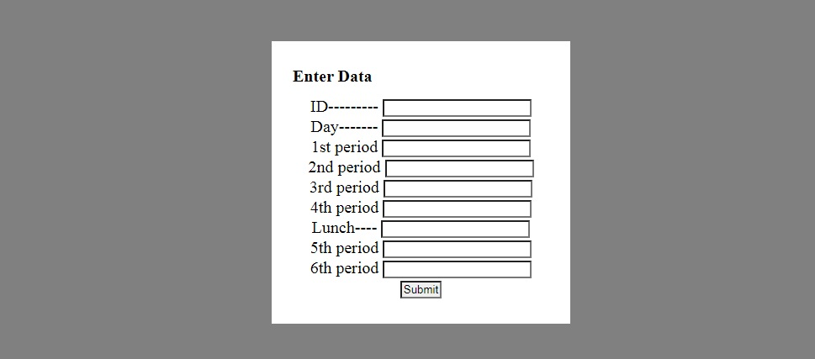
Creation of timetable
Front end: It consist of text view , edit texts for id , day and 1st period, 1st period , 1st period etc and a button to create the timetable.
Back end : database stores the data and display at the “view.php” page.

Slide 11
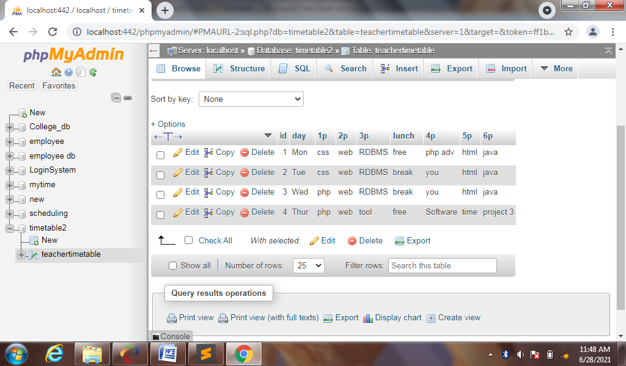
Database

Slide 12
The technology platform we used in our project is “Application platform”.
Ampps
mysql
web browser.

Slide 13
Application feature overview
Reduce redundancy.
Data security
Reduce paperwork

Slide 14
Implementation and methodology

Slide 15
Implementation plans are the backbone of the project.
1 ) Interface Implementation
. Login Form
. Dashboard
. Display data
2) Database Implementation
. MYSQL
. phpMyAdmin

Slide 16
3 ) Logic Implementation
Implementation of the logic of the timetable (Algorithm), constraints or rules, verification, timetable generation, view, delete and edit operations.

Slide 17
Admin Login

Slide 18
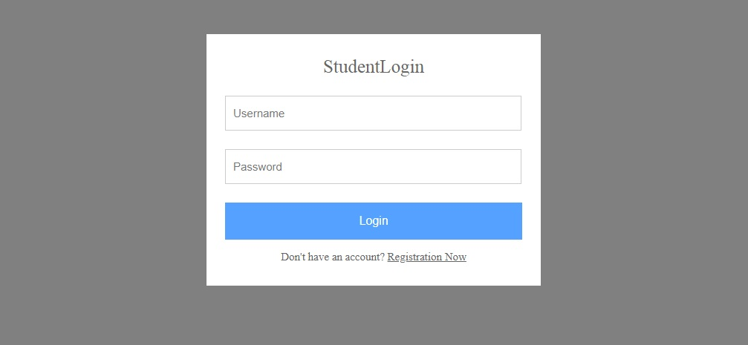
Student Login

Slide 19
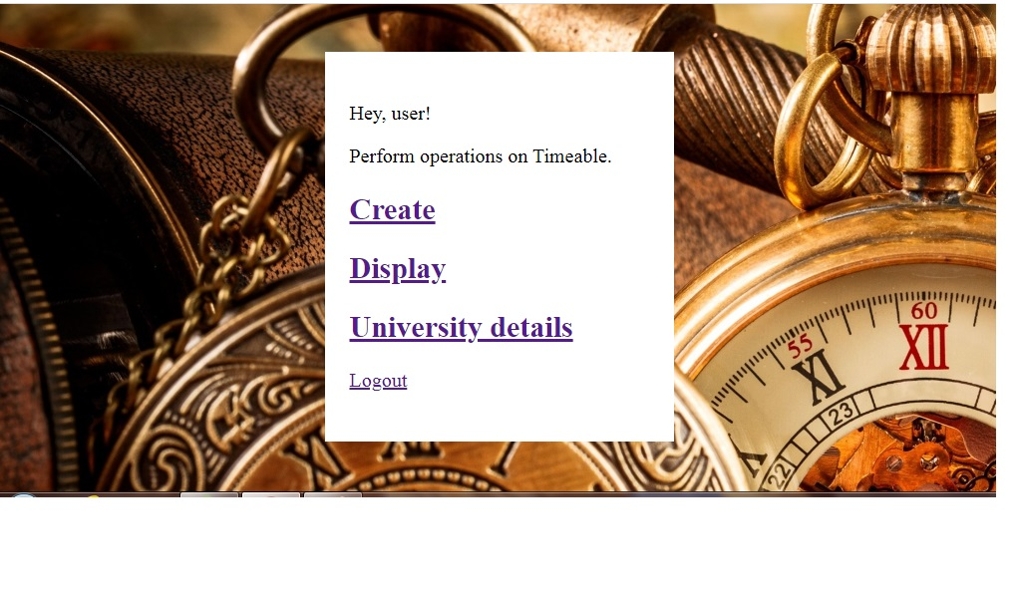
Dashboard

Slide 20
Entries

Slide 21
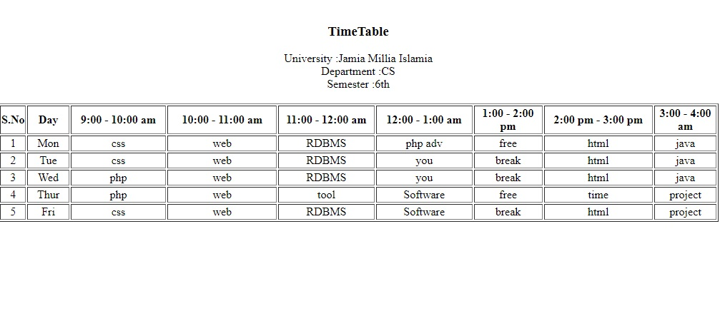
Timetable

Slide 22
CONCLUSION
The application will make the procedure of time table generation easier consistently which may otherwise need to be done using spread sheet manually which might lead to constraints problem that are strenuous to establish when time table is generated physically. The purpose of the algorithm is to generate a timetable schedule mechanically. The algorithm includes many techniques, aimed at improving the efficiency of the search operation. Effective time management is what makes success possible.

Slide 23
THANK YOU

